Slide 1

Education Bot
By: Prashant Trivedi
Samarth Swaroop Saxena

Slide 2

What is Automation?
According to” Encyclopedia of Library and Information science"
"automation is the technology concerned with the design and development of process and system that minimi1ethe necessity of human intervention in operations.
According to “oxford English Dictionary”
defines automation as "application of automatic control to any branch of industry or science by extension, the use of electronic or mechanical devices to replace human labor”.
So we can say “Automation is the use of machines, control system and information technologies to optimize productivity in the delivery of service”.

Slide 3

What is E-Bot?
Education Bot (E-Bot) is a learning platform for online learners.
Main purpose of automate content is to help the learners and the faculty staff to carry out the learning in fast and accurate way and to enhance learners ability to function.
In a simple and easy language “when machineries are used for collection of processing, storage and retrieval of learning content are carried out with the help of machineries, that is called ”E-Bot”.

Slide 4

Need of automated learning
• Better access to the collection.
• Speedup of searching for users.
• Availability of information in various formats i.e. print, non-print, graphical, audio and visual etc.
• Storage, retrieval and protection of Information.
• Accuracy reliability and standardization of content.
• Improve the quality speed and effectiveness of services and operations.
• Facilitate wider dissemination of learning Content.

Slide 5
Cont.….
• Ease of maintenances of statistics and over dues.
• F0llow easy sharing of resource sharing with every beginner.
• To provide OPAC (Online public access catalog)to the users.
• Easier access the content links.
• Time saving of clerical and repetitive tasks.

Slide 6

objective
• E-Bot is basically a idea for those who are beginner on online leaning platform.
• To avoid duplication of content and provide concrete and crisp content.
• To provide easy access to learners by giving a single link for their content.
• To provide access to information at a faster rate and dissemination of information effectively.
• To effectively share the resources among beginners at local, every education level.
• Implementation of new IT processes to provide high quality information.
• To use the services of the existing learning phase by online links.

Slide 7
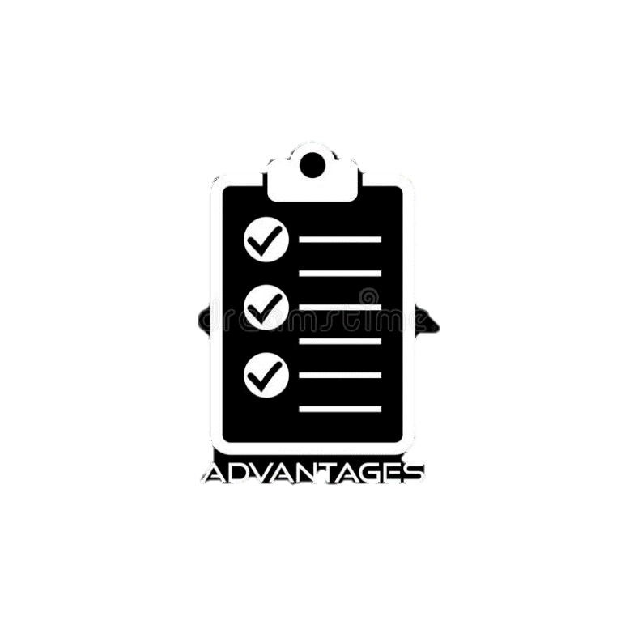
advantages
• Provides users with easier and timely access to various learning materials.
• Time saving for educators and readers and also reduces the amount of the time spent on material acquisition, serials etc.
• Eliminates routine and repetitive tasks by performing more quickly and effectively.
• Accurate learning with no cost estimation.
• Follow single alphabet for searching the content.

Slide 8
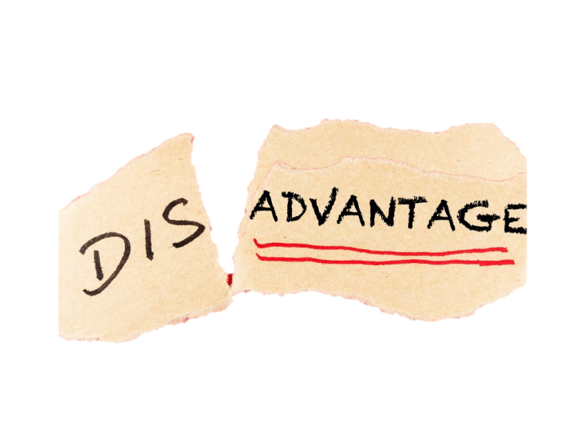
disadvantages
• No backup of content
• Run on PCs.
• Internet connection.
• Be online.
• Security problem.
• Platform Dependent
• Untrained users.

Slide 9
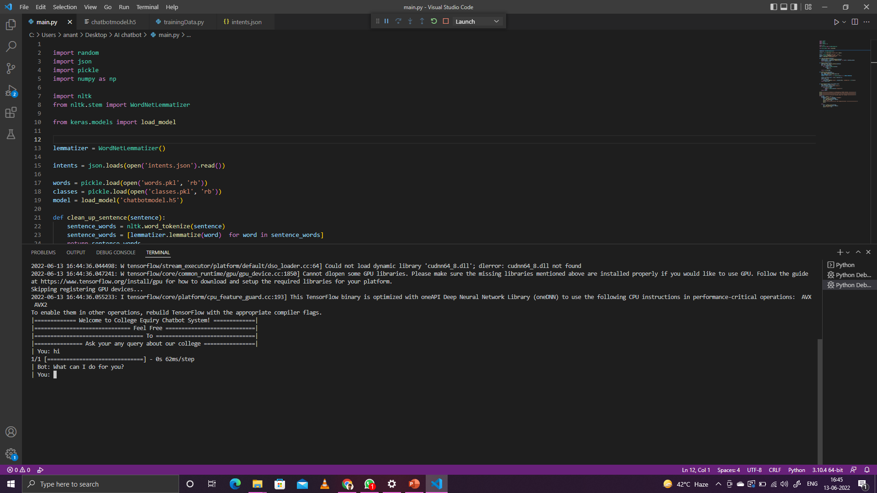

Slide 10
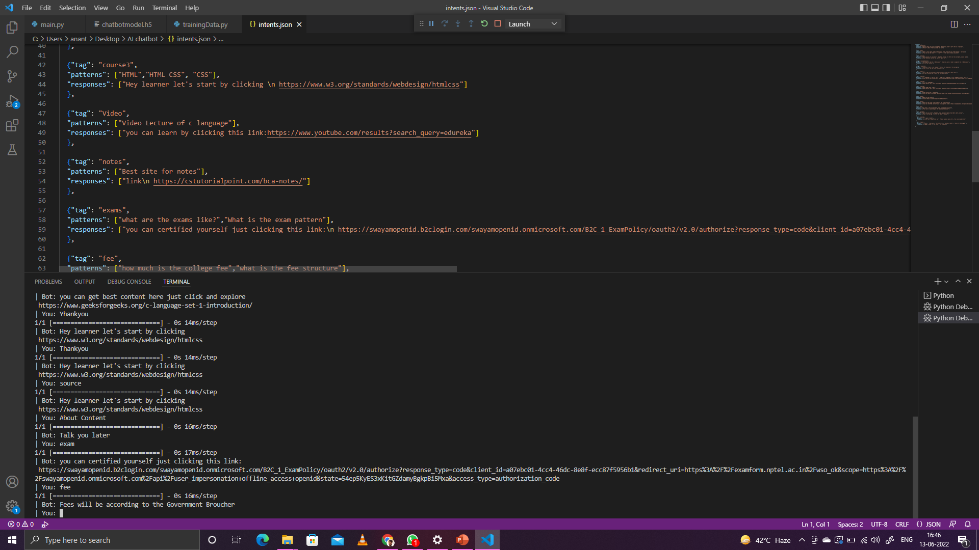

Slide 11

Dreaming for automation is a night issue, but it consumed several nights without any dream……

Slide 12
“Thank you”

